Slide 1
UWI Alumni Registry
Done By: Sanjay Dookhoo

Slide 2
Problem/Solution
UWI does not have an existing method to maintain communications with graduated students
Similarly, graduated students experiences cannot be properly represented and analyzed for future decision making
Target audience/Users: Graduate Students, UWI Staff
Platform: Web (interoperability desired)
The project focuses on representing big data in a more intuitive way
The schema of the database provided determines which charts can be created using different attributes, hence more time can be spent analyzing data rather than creating the chart representation
Because the general representation of a set of usable charts stems from the schema utilized, the project can be extended and reused for other projects that require analyzing of data

Slide 3
Architecture and Method of visual analysis
Acquire
UWI Alumni Registry Architecture
Client (Browser)
Deliver
Filter
Server (Node)
Mongoose
MongoDB
Tune
Enhance

Slide 4
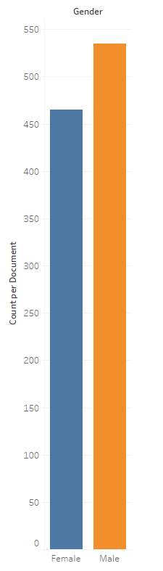
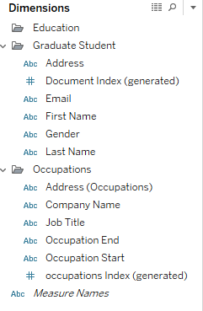
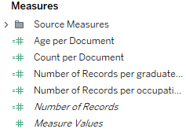

Example of visual analysis

